Slide 1
Long Short-Term Memory
KISTI AI class 2022
ARTICLE RVIEW
Dieu Ni Thi Doan
Ph.D. Student, KIOM school

Slide 2
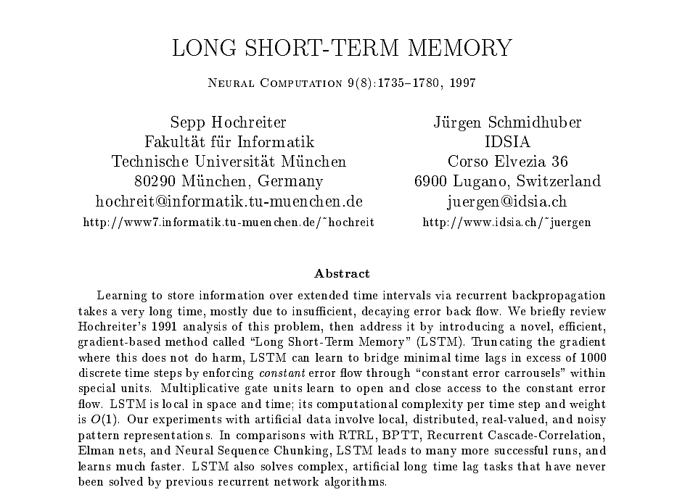
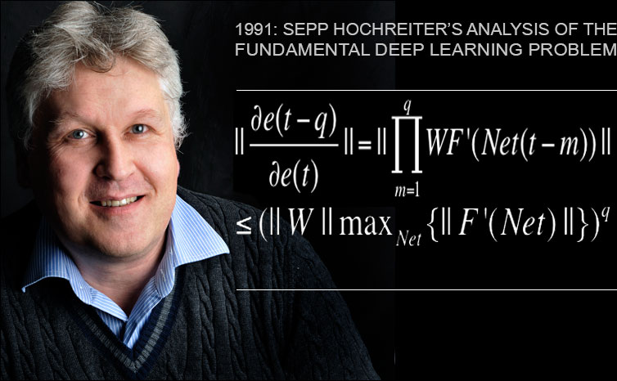
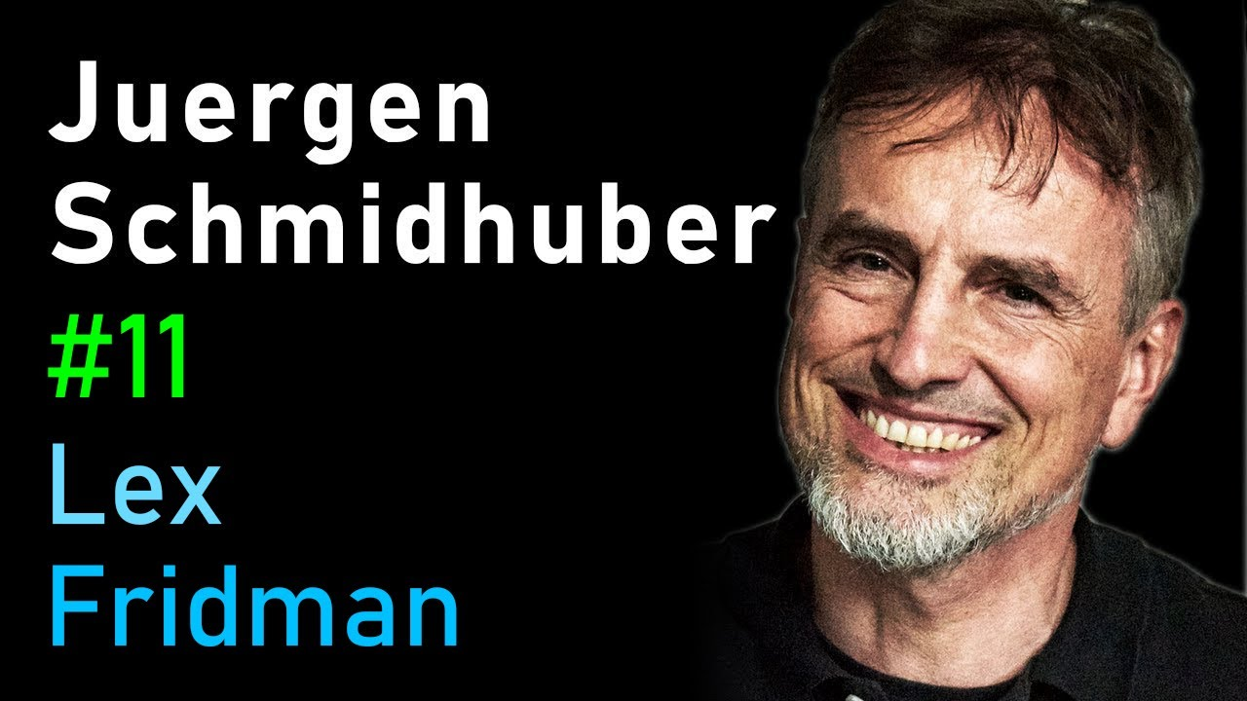

Slide 3



RELATED PUBLICATIONS WITH LSTM AND AD MCI

Slide 4
OUTLINES
Backgrounds
Limitations of previous works
What is LSTM
Data-centric experiments using LSTM
Advantages of LSTM
Disadvantages of LSTM
Conclusion

Slide 5
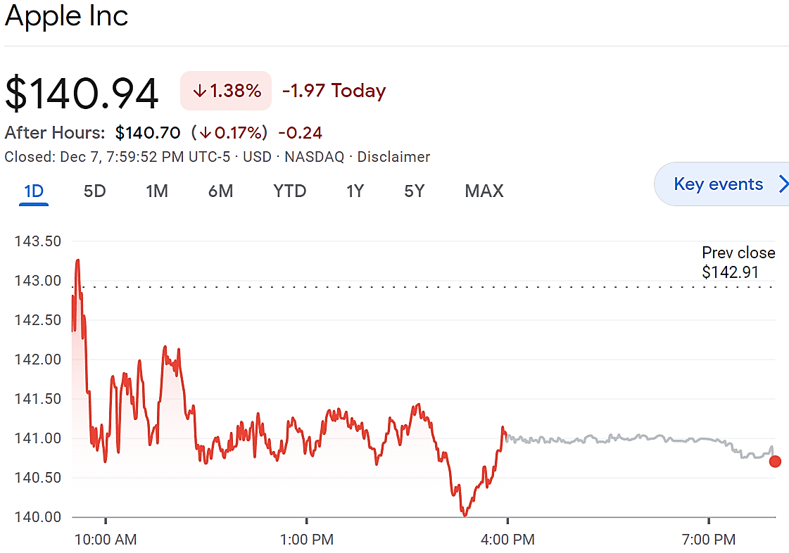
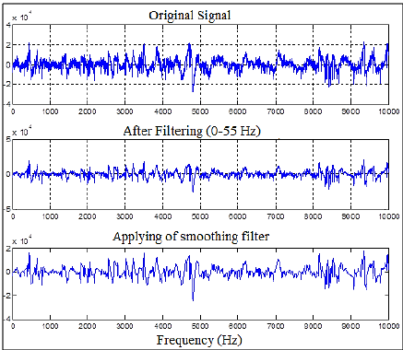
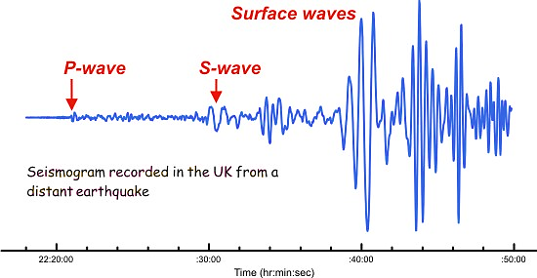
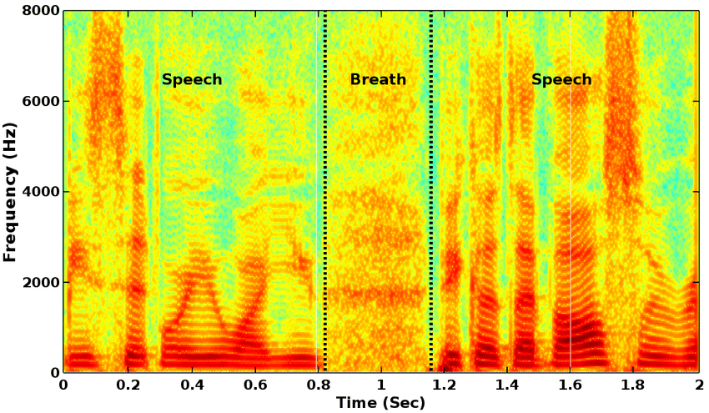
TIME SERIES SIGNALS
Time-varying (or time series) signals are the inputs that time-dependent and relatively related to each others
Stock prize
Resting stage EEG signals
Speech
Breath
Speech
Frequency (Hz)
Earthquake signals on seismogram
Speech signals on spectrogram

Slide 6
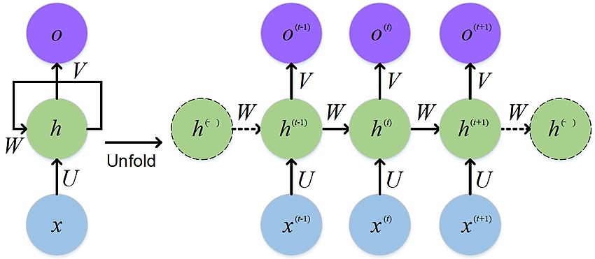
TIME SERIES SINALS PROCESSING
RNN can use their feedback connections to store representations of recent input events and predict the future events.
Different input sizes
Same weight, bias, and activation function for each input
Unrolling a Vanilla RNN
y₁
y₂
y₃
y_{n}
f(x_{n}*w₁ +
y_{n-1}*w₂ +
b₁)
*w₂
f(x₂*w₁ +
y₁*w₂ +
b₁)
f(x₃*w₁ +
y₂*w₂ +
b₁)
*w₂
. . .
*w₂
f(x1*w1 + b1)
*w₁
*w₁
*w₁
x₁
x₂
x₃
x_{n}
An example of Vanilla RNN

Slide 7
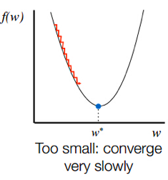
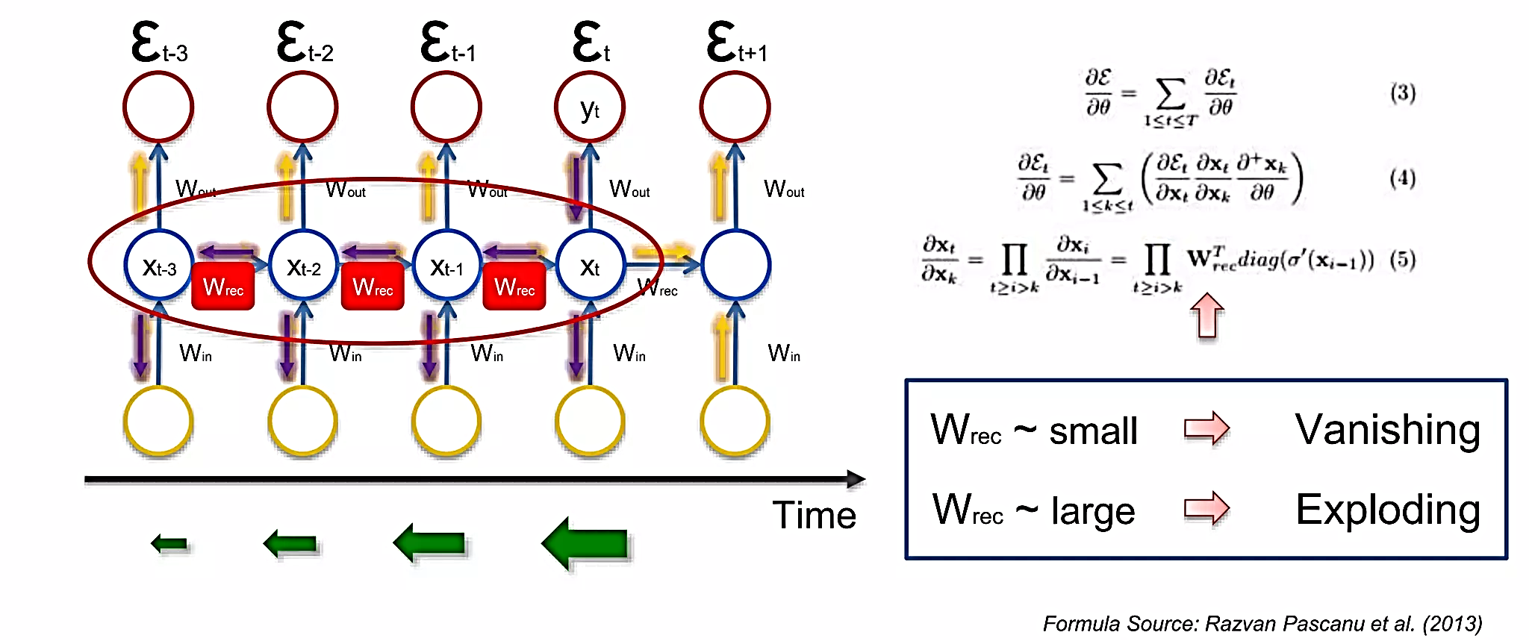
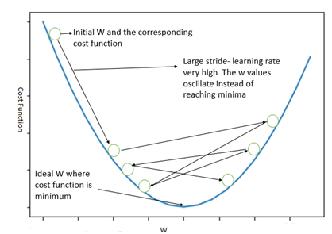
LIMITATIONS OF RNN
Vanishing/exploding problems
With conventional backpropagation through time or real-time recurrent learning, by folding many layers, tuning parameters are exponentially accumulated

Slide 8
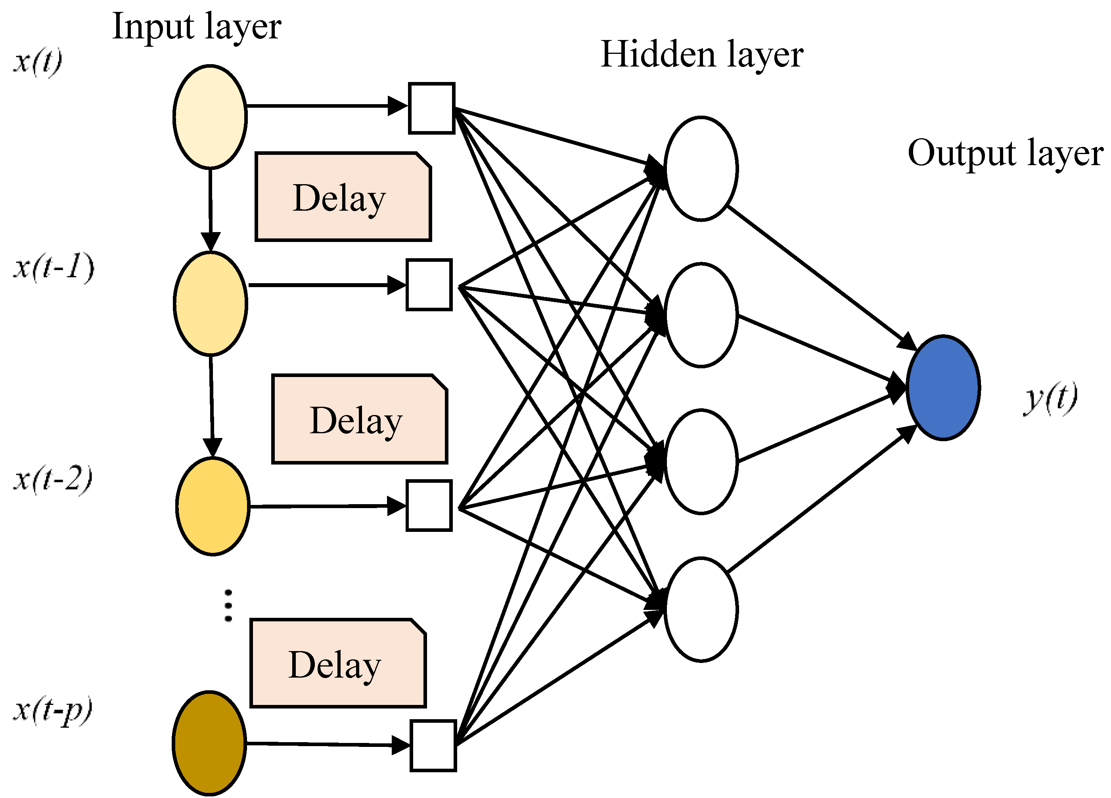
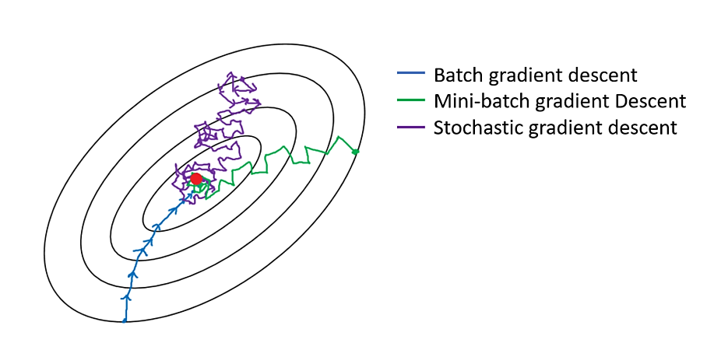
OTHER DATA SEQUENCE APPROACHES
Whenever a unit of Ring’s network receives a conflicting error signals, a higher-order unit will be added to influence appropriate connections.
Update unit activations based on a weighted sum of old activations
Gradient-Descent Variants
Time Delays (NARX)
Ring’s Approach

Slide 9
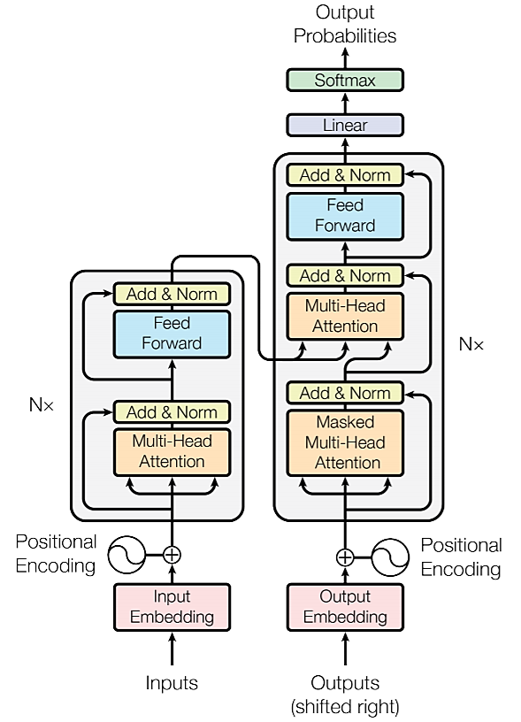
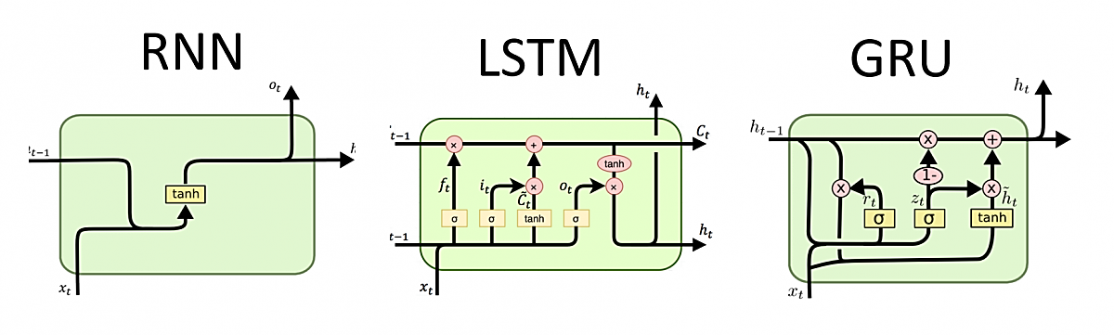
LONG SHORT-TERM MEMORY (LSTM)
Transformer
A structure that allows a constant error to flow through special self-connected units of three gates (input, forget, output) in the memory cells
Are believed to solve the vanishing/gradient problems

Slide 10
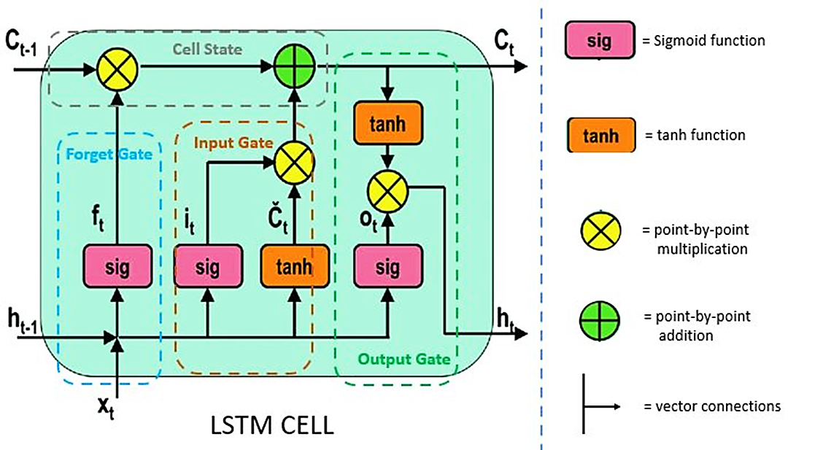
THE CONCEPT OF LSTM
Memory cell of LSTM contains input gate, forget gate, and output gate. These gates play as controller of how much a current input will contribute into the long term memory and produce the cell stage as well as the output of that current input to send to the next module.

Slide 11
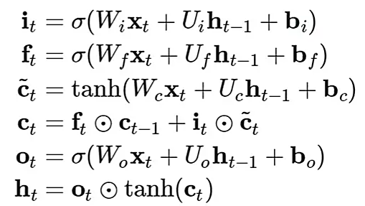
LSTM INTERNAL FORMULATIONS

Slide 12
FORGET GATE
Control how much a current memory will be forgotten in the long term memory by a multiplicative unit.
Sigmoid is used as an activation function (0:1).
Weight and bias parameters can be updated during training.

Slide 13
INPUT GATE
Control how much a current memory will be added into the long term memory by an additive unit.
Sigmoid and tanh are used as activation functions.
Input gate may use the inputs from other memory cells to decide whether to store certain information into its memory cell.

Slide 14
OUTPUT GATE
Generate the value of hidden state to send to the next memory cell.
Tanh function of the cell state times with sigmoid function of the current input concatenate with the current hidden state to provide the next hidden state output.
Cell state remain the same after adding the input gate information and be sent to the next memory cell.

Slide 15
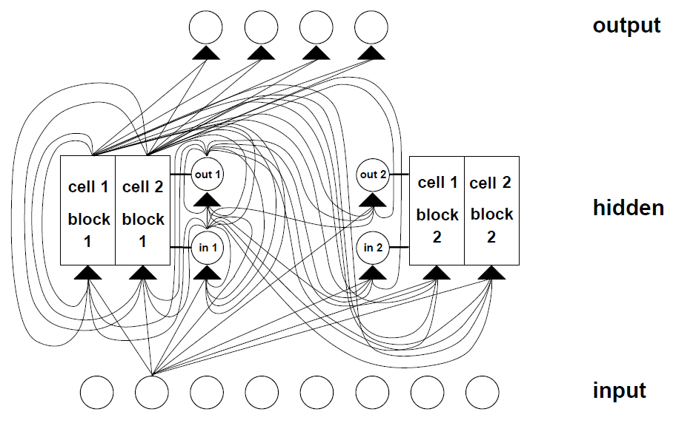
NETWORK TOPOLOGY

Slide 16
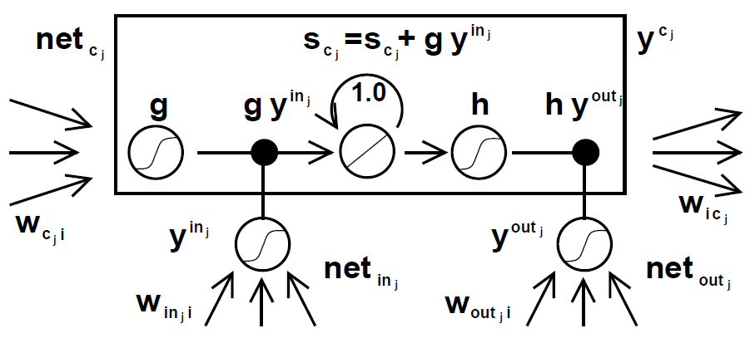
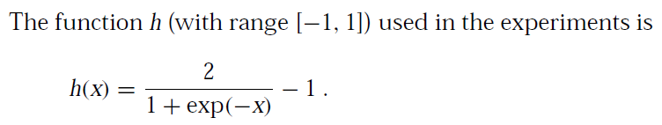
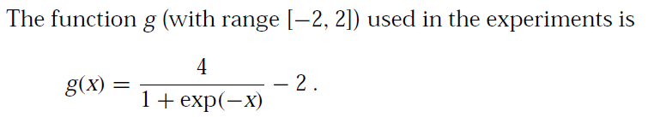
MEMORY CELL BLOCKS

Slide 17
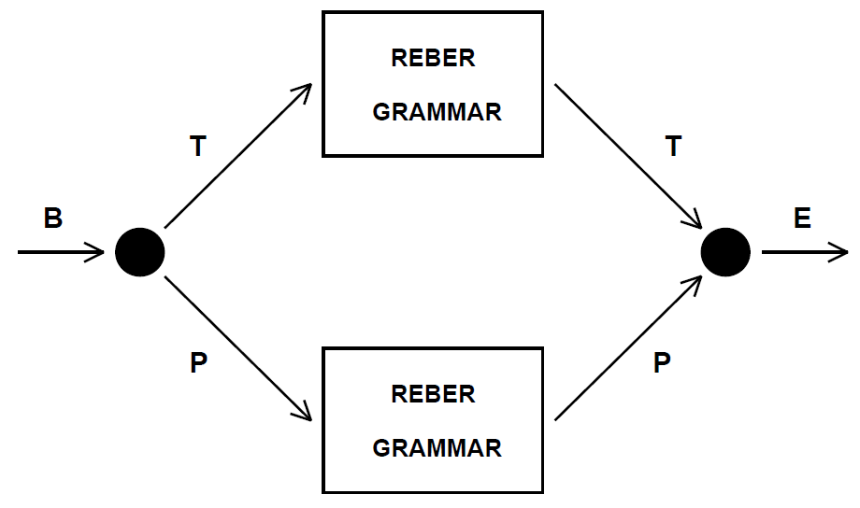
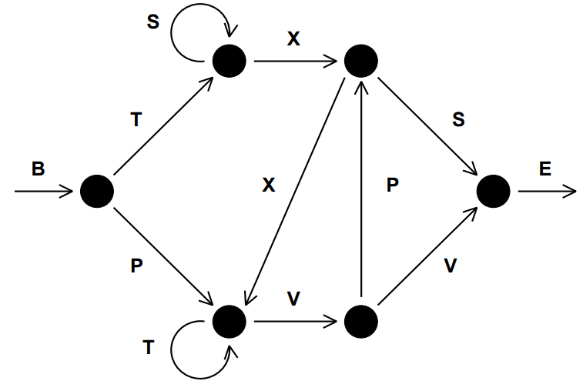
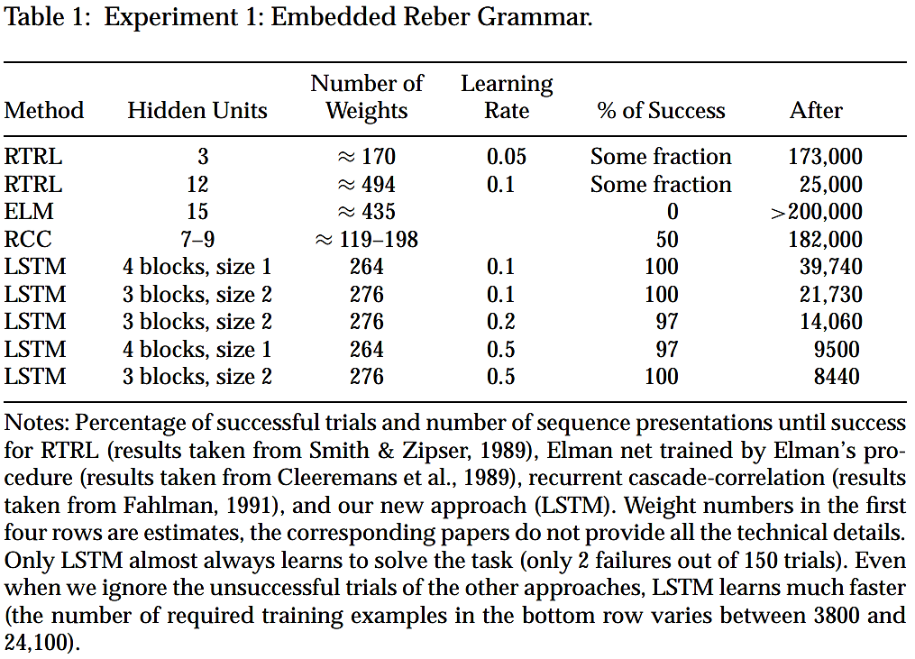
EXPERIMENTS
Embedded Reber grammar
Transition diagram for the
Reber grammar
Reber grammar or string generator can generate an infinite number of strings which belong to a peculiar Reber language.
Only considered short time lags problem: 9 steps
256 training strings, 256 test strings (randomly generated from Reber grammar)

Slide 18
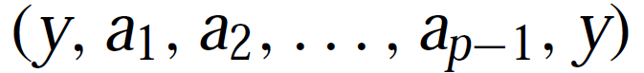
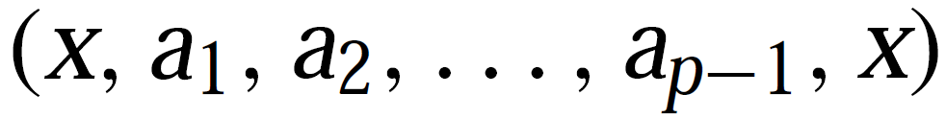
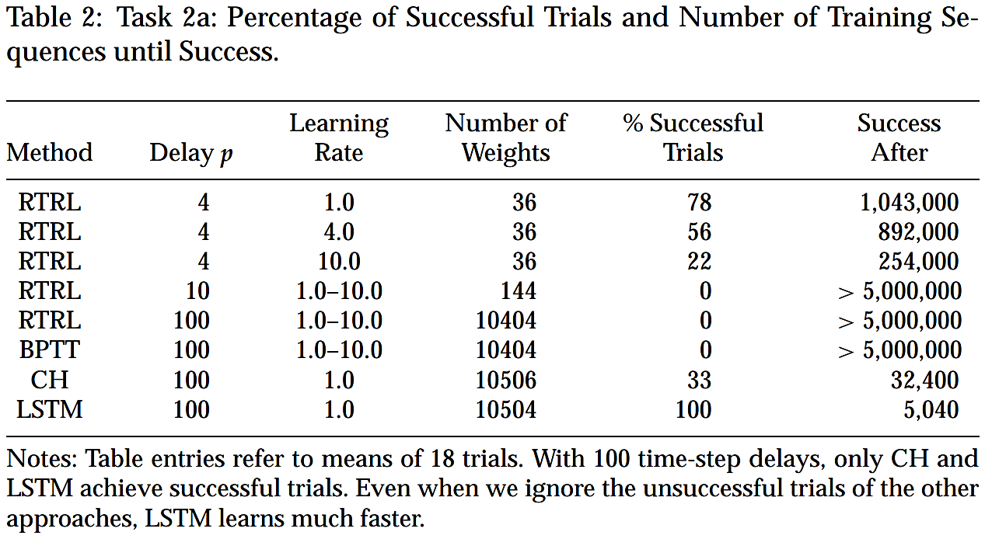
EXPERIMENTS
2A. Noise-free
Two very similar sequences
Sequence Prediction task: the network has to predict the next input of a sequence of p + 1 possible input symbols denoted as a1, ..., ap−1, ap = x, ap+1 = y.
Noise free version: every symbol is represented by the p+ 1 input units with the i^{th} unit set to 1 and all the others to 0.
At every time step a new input of the sequence is presented. For both sequences the network has to store a representation of the first element in the memory cell for the entire length of the sequence (p).

Slide 19
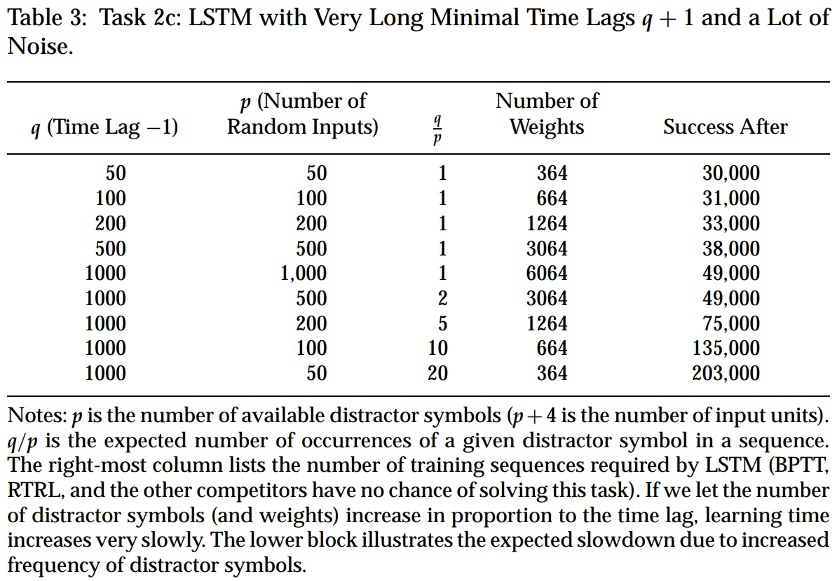
EXPERIMENTS
2B. Noisy Sequences
Two sequences with random orders:
(a₁, a_{p-3}, a_{p-8},…, a_{p}, a_{p+1})
(a₃, a_{p-1}, a_{p-4},…, a_{p}, a_{p+1})
Noisy version: the network still has to predict the next input of the sequence, but the symbols from a₁ to a_{p−1} are presented in random order and the same symbol can occur multiple times.
Therefore, only the final symbols a_{p} and a_{p+1} can be correctly predicted.
This version of the sequence prediction task avoids the possibility that the network learns local regularities in the input stream.

Slide 20
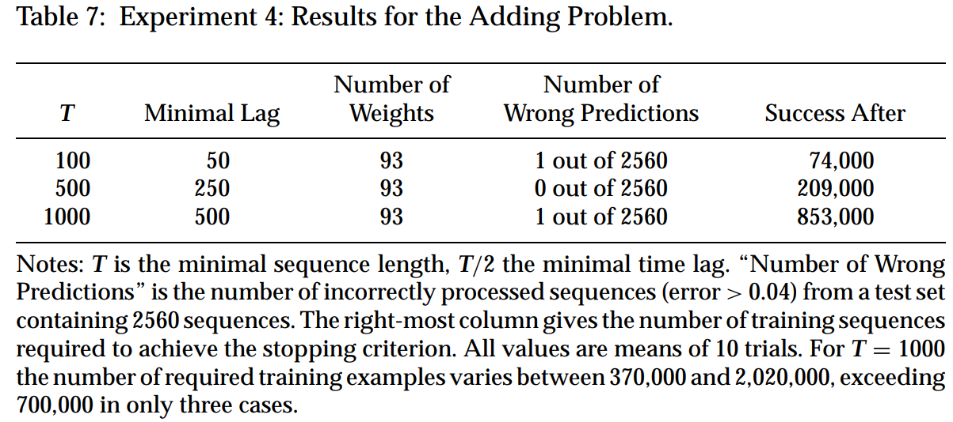
EXPERIMENTS
3. Adding Problem
Difficult task: the task is to output the sum of the first components of those pairs that are marked by second components equal to 1.0
The difficult task in this section is of a type that has never been solved by other recurrent net algorithms.
It shows that LSTM can solve long-time-lag problems involving distributed, continuous-valued representations.
Sequences have random lengths between the minimal sequence length T and T + T/10.
X₁: random value within [-1,1]
X₂: either 1.0, 0.0, or -1.0 (marker)
(X₁, X₂)

Slide 21
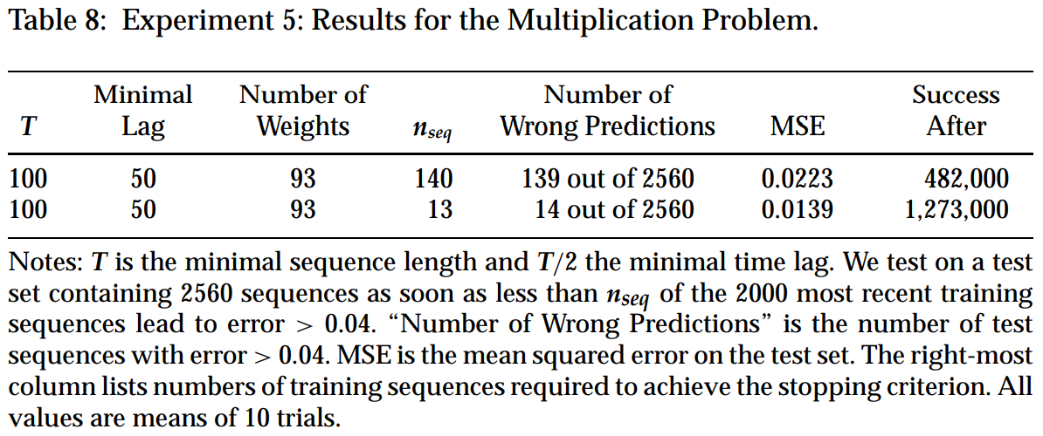
EXPERIMENTS
4. Multiplication Problem
Difficult task: the task is to output the multiplication of the first components of those pairs that are marked by second components equal to 1.0.
One may argue that LSTM is a bit biased toward tasks such as the adding problem from the previous subsection.
The question arises whether LSTM can also solve tasks with inherently non-integrative solutions.
The experiment demonstrates that LSTM can solve tasks involving both continuous-valued representations and non-integrative information processing.
X₁: random value within [0,1]
X₂: either 1.0, 0.0, or -1.0 (marker)
(X₁, X₂)

Slide 22
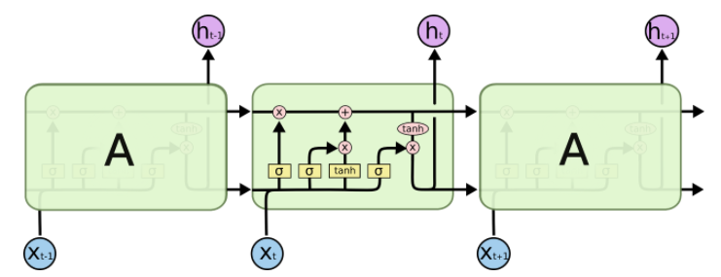
ADVANTAGES OF LSTM
The constant error backpropagation within memory cells results in LSTM’s ability to bridge very long time lags.
LSTM can handle noise, distributed representations, and continuous values, LSTM does not require an a priori choice of a finite number of states. In principle, it can deal with unlimited state numbers.
There appears to be no need for parameter fine tuning. LSTM works well over a broad range of parameters such as learning rate, input gate bias, and output gate bias.
LSTM is local in space and time.

Slide 23
LIMITATIONS OF LSTM
LSTM cannot solve the vanishing gradients problem completely.
Require a lot of memory and time to train
Be affected by random weight initialization.
Prone to be overfitting. Difficult to apply the dropout algorithm.

Slide 24
CONCLUSIONS
The input gate can allow incoming signal to alter the state of memory cell or to block it.
The output gate can allow the memory cell to have an effect on the next units or to prevent it.
The forget gate allows a cell to remember or forget its previous state if needed.
The multiplicative gates allow LSTM to store or access information over a long period of time, thereby mitigating the vanishing gradient problem.
LSTM still has many limitations in which future approaches such as Transformer can overcome.

Slide 25
THANK YOU FOR LISTENING
Q&A

